Slide 1

IMPLEMENTATION OF KNN, HBOS AND LOF ALGORITHMS
USING HTTP REQUEST DATASET
Group Members
Raloue R Kapoor
Akshiti Parashar
Ansh Tiwari
Srihari Ananthan

Slide 2
INDEX
INTRODUCTION
COMMON CODE
IMPORTING LIBRARIES
FUNCTION FOR DATA PREPROCESSING
FUNCTION FOR CONVERTING CLASSES TO NUM(-1,0,1)
FUNCTION FOR GETTING OPTIMAL HYPERPARAMETERS
FUNCTION FOR PRINTING RESULTS
THE PROBLEM STATEMENT
KNN
HBOS
LOF
WITHOUT NOVELTY
WITH NOVELTY
Notes:
Srihari

Slide 3
INTRODUCTION
This is a recap of the algorithms we have learnt till now, that are used for unsupervised Anomaly detection- that is, to find out outliers in data sets without any prior training. We shall be exploring three algorithms- K-Nearest Neighbors, Histogram Based Outlier Scores and Local Outlier Factor. As assigned, we have used the HTTP dataset for our work, the results of which have been attached for better understanding of how these algorithms work, along with due explanation of the code.
Notes:
Akshiti

Slide 4
2.1 IMPORTING LIBRARIES
NumPy provides n-dimensional array object. Also provides mathematical functions which can be used in many calculations.
import numpy as np
import pandas as pd
import matplotlib.pyplot as plt
from sklearn.preprocessing import StandardScaler
from sklearn.model_selection import train_test_split
from sklearn.neighbors import KNeighborsClassifier,LocalOutlierFactor
from sklearn.metrics import confusion_matrix,classification_report,roc_curve,auc
from pyod.models.hbos import HBOS
PyOD- Python Outlier detection -for anomaly detection modeling with supervised and unsupervised learning techniques
Scikit-learn- provides tools for data analysis and data mining. It provides classification and clustering algorithms.
Pandas- used for data analysis. It can take multi-dimensional arrays as input and produce charts/graphs.
Matplotlib- scientific plotting library usually required to visualize data.
Notes:
Raloue

Slide 5
2.2 FUNCTION FOR DATA PREPROCESSING
def data_preprocessing(input_data):
df = pd.read_csv('/content/drive/My Drive/Com-Olho-Datasets/'+input_data+'.csv',header=None)
l = df.columns.values.tolist()
lastcolname = l[-1]
df = df.rename(columns = {lastcolname:'TV'})
datay = df['TV']
datax = df.drop(['TV'],axis=1)
scaler = StandardScaler()
scaler.fit(datax)
datax = scaler.transform(datax)
return datax,datay
Loading the data into the dataframe
Renaming last column as ‘TV’ (Test Vector)
Dividing the data into 2 parts for data standardization
Standardize/Cleaning data
Notes:
Akshiti

Slide 6
2.3 FUNCTION FOR CONVERTING CATEGORICAL CLASSES TO BINARY
def convert_to_num(datay,algotype):
if algotype == 'KNN' or algotype == 'HBOS':
datay = datay.replace({'n': 0,'o': 1})
elif algotype == 'LOF_no_novelty' or algotype == 'LOF_novelty':
datay = datay.replace({'n': 1,'o': -1})
return datay
n: Normal
o: Outlier
Notes:
Raloue

Slide 7
2.4 FUNCTION FOR FINDING HYPERPARAMETERS
def findhyperparameter(algotype,xtrain,ytrain,xtest,ytest):
error_rate = []
hplist = []
if algotype is 'KNN':
for i in range(1,50):
print("Checking k="+str(i))
neigh = KNeighborsClassifier(n_neighbors=i)
neigh.fit(xtrain,ytrain)
pred = neigh.predict(xtest)
error_rate.append(np.mean(pred!=ytest))
elif algotype is 'LOF_no_novelty':
for i in range(10,20):
print("Checking k="+str(i))
clf = LocalOutlierFactor(n_neighbors=i)
pred = clf.fit_predict(xtrain)
error_rate.append(np.mean(pred!=ytrain))
elif algotype is 'LOF_novelty':
for i in range(10,20):
print("Checking k="+str(i))
clf = LocalOutlierFactor(n_neighbors=i,novelty=True)
Hyperparameters:
Type of algorithm
Training set
Testing set
Finding minimum error by passing different values of nearest neighbors (k)
Notes:
Srihari

Slide 8
clf.fit(xtrain)
pred = clf.predict(xtest)
error_rate.append(np.mean(pred!=ytest))
elif algotype is 'HBOS':
for i in range(10,100):
print("Checking n_bins="+str(i))
clf = HBOS(n_bins=i)
clf.fit(xtrain)
pred = clf.predict(xtest)
error_rate.append(np.mean(pred!=ytest))
for i in range(10,20):
hplist.append(i)
min_val = min(error_rate)
ind = np.where(error_rate == min_val)
ind = ind[0][0]
return hplist[ind],hplist,error_rate
Finding minimum error by passing different values of bins (n)
Getting index where error rate is minimum
Notes:
Srihari

Slide 9
2.5 FUNCTION FOR PRINTING RESULTS
def print_results(optimal_value,hpvalues,error_rate,y_test,preds,dataset,algotype):
print("This is an analysis for "+algotype+" on "+dataset+" dataset")
print("Optimal value is "+str(optimal_value))
plt.plot(hpvalues,error_rate)
plt.title('error rate vs hpvalues')
plt.xlabel('hpvalues')
plt.ylabel('errorrate')
plt.show()
cm = confusion_matrix(y_test,preds)
cr = classification_report(y_test,preds)
print("Printing confusion matrix")
print(cm)
print("Printing classification report")
print(cr)
print("Printing ROC_AUC Curve")
fpr,tpr,threshold=roc_curve(y_test,preds)
roc_auc=auc(fpr,tpr)
plt.plot(fpr,tpr,roc_auc)
plt.show()
hpvalues: Hyperparameter values
AUC: Area Under Curve
ROC: Receiver Operating Characteristics curve
Notes:
Ansh

Slide 10
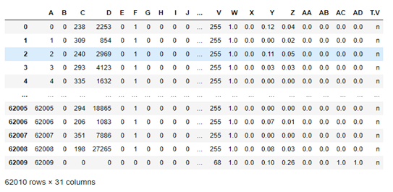
3.PROBLEM STATEMENT -
THE HTTP REQUEST DATASET
X : INDEPENDENT VARIABLES
Y : DEPENDENT VARIABLE
Notes:
Ansh

Slide 11
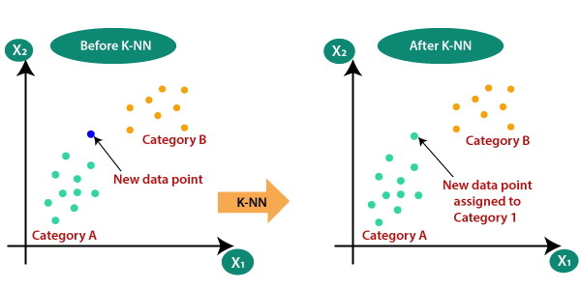
4. K-Nearest Neighbors
K-Nearest Neighbors is an algorithm for supervised learning. Where the data is 'trained' with data points corresponding to their classification. Once a point is to be predicted, it takes into account the 'K' nearest points to it to determine its classification.
Notes:
Ansh

Slide 12
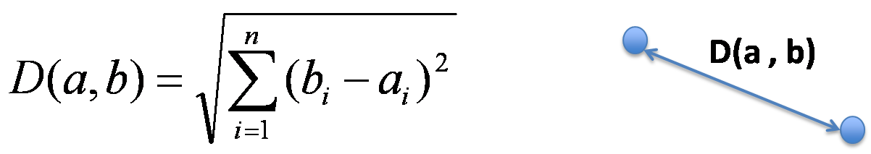
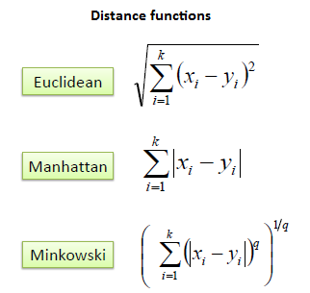
Euclidean distance formula for multi-dimensional vectors :
KNN ALGORITHM
Import unsupervised .csv file and convert
it to supervised.
Convert categorical classes into binary.
Do standardization on independent
variables.
Perform train test split.
Do classification..
Plot accuracy and filter out best K.
Plot error rate curve
Predict the model.
Get confusion matrix and compute classification report for best K.
Get ROC curve and find AUC.

Slide 13
def KNN_algorithm(dataset):
datax,datay = data_preprocessing(dataset)
print("Data Preprocessed")
datay = convert_to_num(datay,'KNN')
x_train,x_test,y_train,y_test = train_test_split(datax,datay,test_size=0.3,random_state=4)
optimal_value,hpvalues,error_rate = findhyperparameter('KNN',x_train,y_train,x_test,y_test)
print("Optimal value found")
neigh = KNeighborsClassifier(n_neighbors=optimal_value)
neigh.fit(x_train,y_train)
preds = neigh.predict(x_test)
print_results(optimal_value,hpvalues,error_rate,y_test,preds,dataset,'KNN')
Calling the function
Data preprocessing
Converting categorical classes into binary.
Putting optimal value as K
TRAIN TEST SPLIT AND FINDING OPTIMAL K
Fitting and predicting the
x and y train data
Plotting results

Slide 14

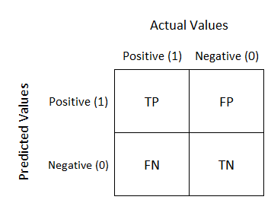
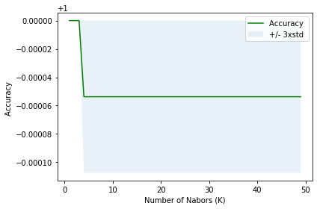
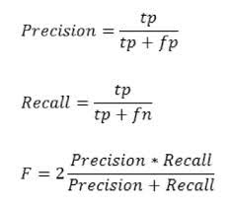
Computation of accuracy using confusion matrix :
TP=18570 | FP=0
FN=1 | TN=32
Prediction conduction positive=TP+FP
=18750
Prediction conduction negative=FN+TN
=33
ACC=(18570+32)/(18570+32+0+1)=0.999=99.99%

Slide 15
Classification report
 | precision | recall | f1-score
0 | 1.00 | 1.00 | 1.00
1 | 1.00 | 0.97 | 0.98
accuracy |  |  | 1.00
macro avg | 1.00 | 0.98 | 0.99
weighted avg | 1.00 | 1.00 | 1.00

Slide 16
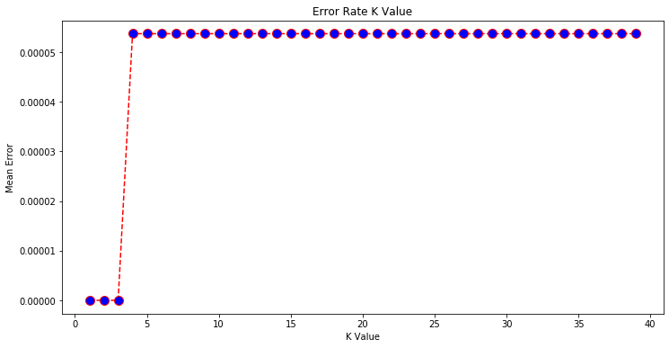
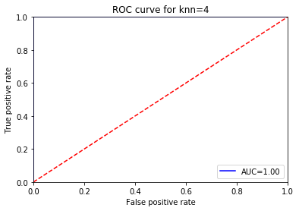
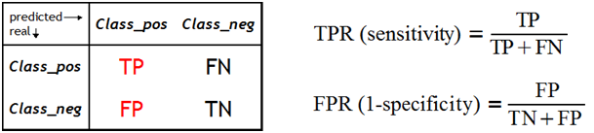
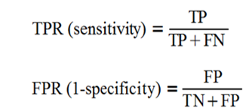
Results
What is the value of the AUROC (area under roc) to conclude that a classifier is excellent?

Slide 17
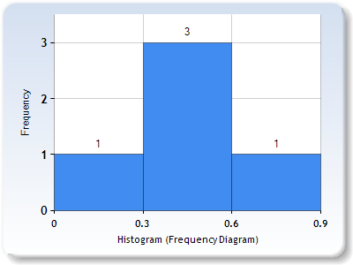
5.Histogram Based Outlier Score
Standardized xtrain data
 | Column A
0 | 0.00
1 | 0.31
2 | 0.90
3 | 0.45
4 | 0.50
nbins = 3
Similarly we find histograms for other columns as well
Min: 0 | Max: 0.9
Notes:
Raloue

Slide 18
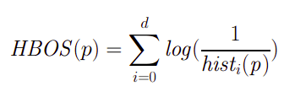
After we have all histograms ready we start bringing in values to calculate the scores for them
Suppose we calculate for x = 0.59
We apply this formula for calculating the scores
0.59
d stands for the number of features or columns
p is the input test data which needs to be checked
hist_{i}p is the frequency for the point p in a histogram
HBOS(0.59) = log(⅓).
Finally we get a score to check for outlier

Slide 19
HBOS FOR REQUESTS DATA
TRAIN TEST SPLIT AND FINDING OPTIMAL NBINS
DATA PREPROCESSING
def HBOS_algorithm(dataset):
datax,datay = data_preprocessing(dataset)
datay = convert_to_num(datay,'HBOS')
x_train,x_test,y_train,y_test = train_test_split(datax,datay,test_size=0.3,random_state=4)
optimal_value,hpvalues,error_rate = findhyperparameter('HBOS',x_train,y_train,x_test,y_test)
clf = HBOS(n_bins=optimal_value)
clf.fit(x_train)
preds = clf.predict(x_test)
print_results(optimal_value,hpvalues,error_rate,y_test,preds,dataset,'HBOS')
TRAINING AND PREDICTING
PRINTING RESULTS

Slide 20
RESULTS
Confusion Matrix
Classification Report
TP = 16726 | FP = 1844
FN = 5 | TN = 28
 | precision | recall | f1-score | support
0 | 1.00 | 0.90 | 0.95 | 18570
1 | 0.01 | 0.85 | 0.03 | 33
accuracy | - | - | 0.90 | 18603
macro avg | 0.51 | 0.87 | 0.49 | 18603
weighted avg | 1.00 | 0.90 | 0.95 | 18603
Accuracy = (TP + TN)
_________________
(TP+TN+FP+FN)
Accuracy = 90.06%

Slide 21
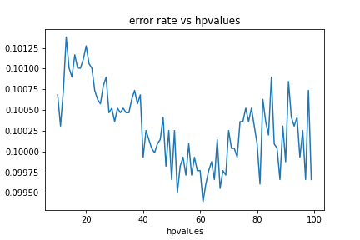
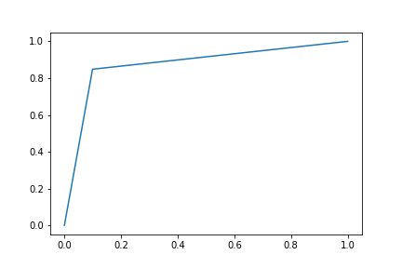
Error rate vs nbins
Roc_curve
True positive rate
AUC = 0.87
False positive rate
Optimal bins was found at nbins = 61

Slide 22
6.Local Outlier Factor
Local Outlier Factor (LOF) is a score that tells how likely a certain data point is an outlier or anomaly.
CONCEPT: Local Density
LOCALITY: k nearest neighbors (Distance=>Density)
OUTLIERS: Points that have a substantially lower density than their neighbors
MATHEMATICAL CALCULATION: a)Look at the neighbors of a certain point
b) Find out its density
c) Compare this to the density of other points later on.
Notes:
Akshiti

Slide 23
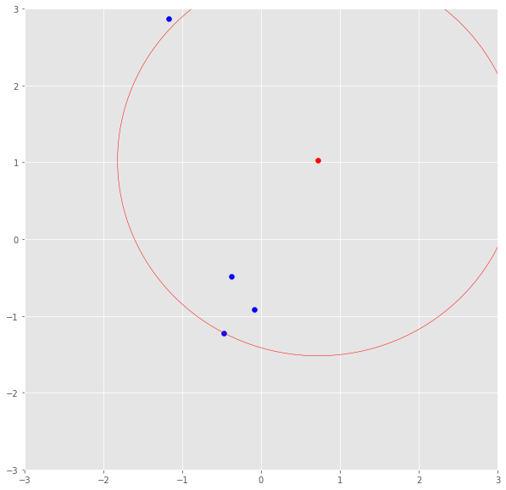
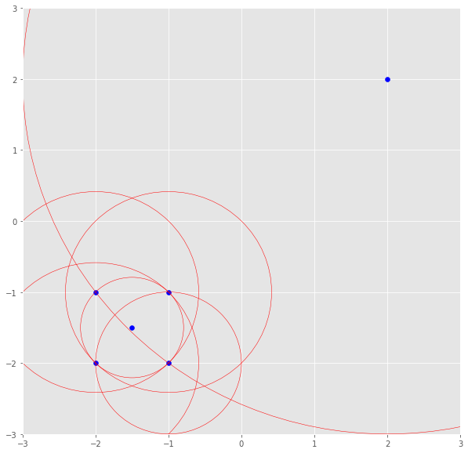
K-distance: Is the distance of a point to its kth neighbor. If k was 3, the k-distance would be the distance of a point to the third closest point.
Reachability distance: The k-distance is now used calculate the reachability distance. This distance measure is the maximum of the distance of two points and the k-distance of the second point.
reach-dist(a,b) = max{k-distance(b), dist(a,b)}
Notes:
Srihari

Slide 24
Local reachability density: The reach-dist is then used to calculate the lrd. Basically, the local reachability density tells how far we have to travel from our point to reach the next point or cluster of points.
lrd(a) = 1/(sum(reach-dist(a,n))/k)
The lrd of each point will then be compared to the lrd of their k neighbors. The LOF is basically the average ratio of the lrds of the neighbors of a to the lrd of a.
LOF ≈1 ⇒ no outlier
LOF ≫1 ⇒ outlier
Notes:
Srihari

Slide 25
Outlier detection | Novelty detection
Observations that are far from the others. Outlier detection estimators try to fit the regions where the training data is the most concentrated. Unsupervised anomaly detection Outliers/anomalies cannot form a dense cluster as available estimators assume that the outliers/anomalies are located in low density regions. | We are interested in detecting whether a new observation is an outlier. Semi-supervised anomaly detection. Novelties/anomalies can form a dense cluster as long as they are in a low density region of the training data, considered as normal in this context.
Notes:
Akshiti

Slide 26
6.1 LOF FOR REQUESTS DATA (without novelty)
DATA PREPROCESSING
TRAINING AND PREDICTING
def LOF_no_novelty_algorithm(dataset):
datax,datay = data_preprocessing(dataset)
print("Data Preprocessed")
datay = convert_to_num(datay,'LOF_no_novelty')
x_train = datax
y_train = datay
x_test = None
y_test = None
optimal_value,hpvalues,error_rate = findhyperparameter('LOF_no_novelty',x_train,y_train,x_test,y_test) clf = LocalOutlierFactor(n_neighbors=optimal_value)
preds = clf.fit_predict(x_train)
print_results(optimal_value,hpvalues,error_rate,y_train,preds,dataset,'LOF_no_novelty')
Data altering and assignment
Printing results
Notes:
Srihari

Slide 27
DATA PREPROCESSING
6.2 LOF FOR REQUESTS DATA (with novelty)
def LOF_novelty_algorithm(dataset):
datax,datay = data_preprocessing(dataset)
datay = convert_to_num(datay,'LOF_novelty')
x_train,x_test,y_train,y_test = train_test_split(datax,datay,test_size=0.3,random_state=4)
ytrainlist = []
for i in y_train:
ytrainlist.append(i)
j = 0
xtrainlist = []
for i in x_train
m = []
m = i.tolist()
m.append(ytrainlist[j])
xtrainlist.append(m)
j = j + 1
df_rejoined = pd.DataFrame(xtrainlist)
df_rejoined = df_rejoined[df_rejoined[30]==1]
new_y_train = df_rejoined[30]
new_x_train = df_rejoined.drop([30],axis=1)
optimal_value,hpvalues,error_rate=findhyperparameter('LOF_novelty',new_x_train,new_y_train,x_test,y_test)
clf = LocalOutlierFactor(n_neighbors=optimal_value,novelty=True)
clf.fit(new_x_train)
preds = clf.predict(x_test)
print_results(optimal_value,hpvalues,error_rate,y_test,preds,dataset,'LOF_novelty')
Test Train split, data append and sorting
TRAINING AND PREDICTING
Printing results
Notes:
Akshiti

Slide 28
RESULTS
LOF with Novelty | LOF without Novelty
Confusion Matrix
Confusion Matrix
33 | 0
879 | 17691
19 | 86
2663 | 59242
Classification Report
Classification Report
 | Precision | Recall | f1-score | support
-1 | 0.04 | 1.00 | 0.07 | 33
1 | 1.00 | 0.95 | 0.98 | 18570
accuracy | - | - | 0.95 | 18570
macro avg | 0.52 | 0.98 | 0.52 | 18570
weighted avg | 1.00 | 0.95 | 0.97 | 18570
 | Precision | Recall | f1-score | support
-1 | 0.01 | 0.18 | 0.01 | 105
1 | 1.00 | 0.96 | 0.98 | 61905
accuracy | - | - | 0.96 | 62010
macro avg | 0.50 | 0.57 | 0.50 | 62010
weighted avg | 1.00 | 0.96 | 0.98 | 62010
Notes:
Akshiti

Slide 29
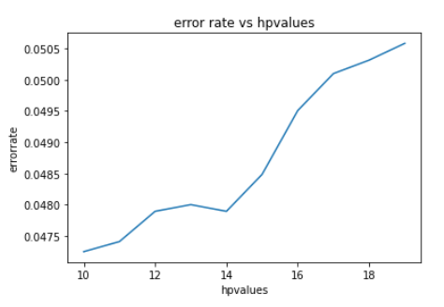
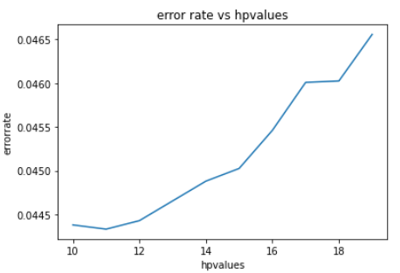
LOF with Novelty | LOF without Novelty
Error rate vs Hyperparameter values | Error rate vs Hyperparameter values
Optimal value is 10 | Optimal value is 11
Notes:
akshiti

Slide 30
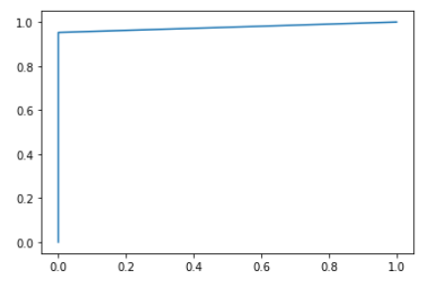
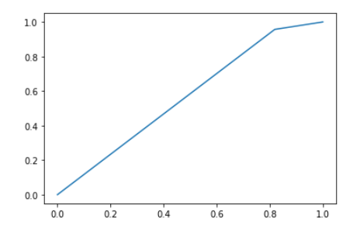
LOF with Novelty | LOF without Novelty
Accuracy: 95.27% | Accuracy: 95.56%
True positive rate
True positive rate
False positive rate
False positive rate
Notes:
srihari

Slide 31
THANK YOU
Notes:
All together wow

